Slide 1
Building a PaN Data Commons on the PaNOSC and ExPaNDS outcomes
NOBUGS 2022
Andy Götz (ESRF + PaNOSC coordinator) + Patrick Fuhrman (DESY + ExPaNDS coordinator)
on behalf of and with contributions by
PaNOSC + ExPaNDS WP2, WP3 + WP4, LEAPS WG3

Slide 2
Talk outline
What are PaNOSC + ExPaNDS?
What are their outcomes?
What is a Data Commons?
Why build a Data Commons?
How to build the Data Commons?
Sustaining the Data Commons?
What is your role in the Data Commons?
Conclusion

Slide 3


The PaNOSC and ExPaNDS H2020 EOSC projects in numbers
 |  | 2019 |  |  |  |  |  |  |  |  |  |  |  | 2020 |  |  |  |  |  |  |  |  |  |  |  | 2021 |  |  |  |  |  |  |  |  |  |  |  | 2022 |  |  |  |  |  |  |  |  |  |  |  | 2023
PaNOSC
ExPaNDS
EU Call | HORIZON 2020 INFRA-EOSC-04 | HORIZON 2020 INFRA-EOSC-5B
Description | Cluster of ESFRI PaN Sources | EOSC PaN Data Services
Partners | ESRF, ILL, ESS, EU-XFEL, CERIC-ERIC, ELI-DC, EGI | DESY, ALBA, DLS, ELETTRA, EGI, HZB, HZDDR, Max IV, PSI, Soleil, UKRI
Observers | GEANT EU-DAT National RI’s
Linked 3rd Party | DESY STFC CESNET
Start – End (Duration) | 2018-12-01 – 2022-11-30 [4 Years] | 2019-09-01 – 2023-02-28 [ 3 ½ Years]
Coordinators | A. Götz, G. Bodera | P. Fuhrmann, S. Servan, J. Marauska
Budget | 12 M Euros | 6 M Euros
Home Page | https://panosc.eu | https://expands.eu
Twitter | @PaNOSC_eu #PaNOSC | @ExPaNDS_eu #ExPaNDS
GitHUB | https://github.com/panosc-eu | https://github.com/expands-eu

Slide 4
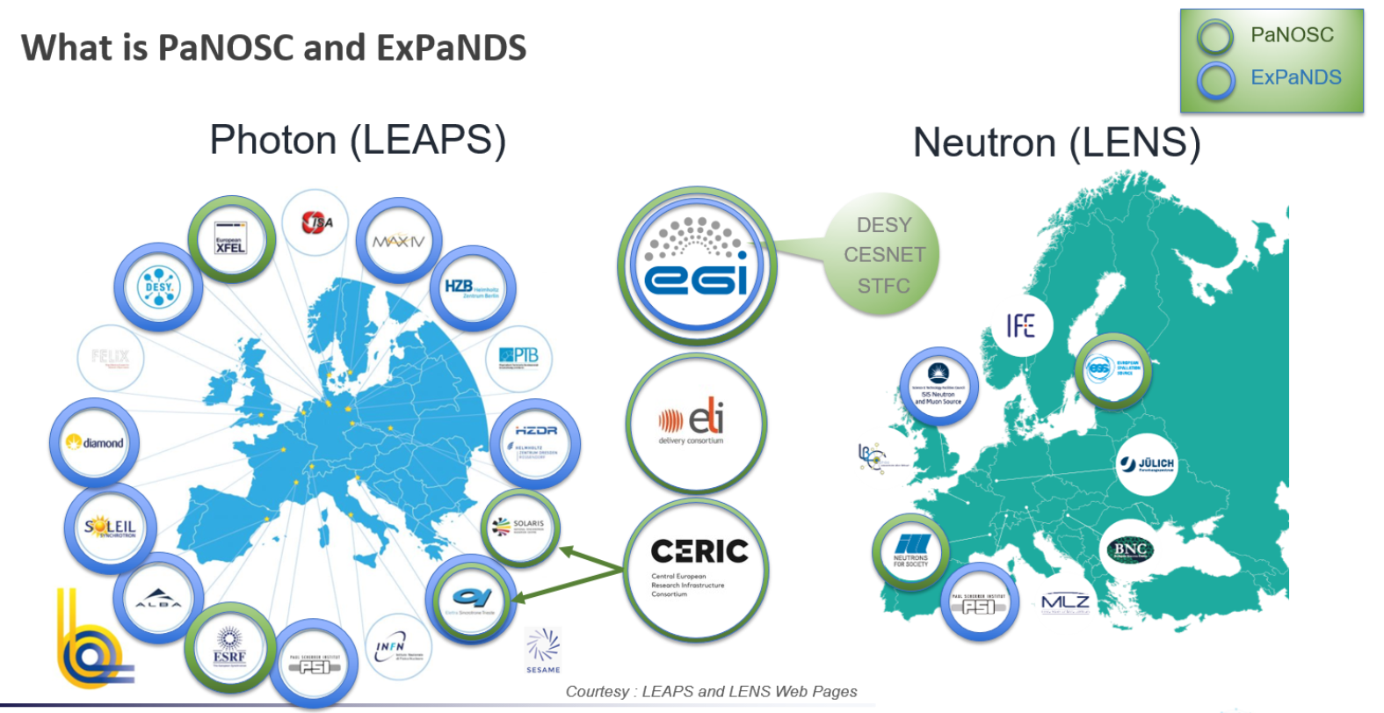

ExPaNDS and PaNOSC in the PaN EU project landscape

Slide 5









ExPaNDS and PaNOSC in the PaN EU project landscape
2010 2015 2018 2021
European Open Science Cloud
2019 | 2020 | 2021 | 2022
Policies
Common data policy
FAIR data policy
Data Management Plans
Analysis
Software Catalogue
Remote analysis
Jupyter
AAI
UmbrellaID
AARC Blueprint
eduTeams
Training
e-neutron
Training platform

Slide 6
The Big Picture of EOSC in PaNOSC and ExPaNDS in
Catalogue Services
Analysis Services
Bio Portal
by NCBO
PaN Training
B2FIND
Open AIRE
PaN Portals
EOSC
Portal
Federated
Services
Doc’s
Metadata and Data
Notebooks
Horizontal
Infrastructure
Moodle
SciCAT
iCAT
Other
K8/VMs
Notebooks
Batch
FAIR
Activities
Ontologies for use in catalogues and data sets (NEXUS)
Consultation
Data Policies and DMP’s (21 data policy key elements)
EGI
PaN Research Infrastructures

Slide 7
10 Primary Outcomes of PaNOSC and ExPaNDS
FAIR data policy and DMPs
FAIR assessment and common PID framework
Standardised metadata (Nexus/HDF5, PaN ontologies)
Federated search API for PaN data catalogues
Open Data portal for searching + downloading data
Community AAI UmbrellaId
JupyterLab notebooks and Nexus/HDF5 files visualisation
Remote data analysis with VISA + data analysis pipelines
Simulation software for simulating experimental data (SIMEX)
PaN-learning platform (pan-learning.org + pan-training.org)

Slide 8
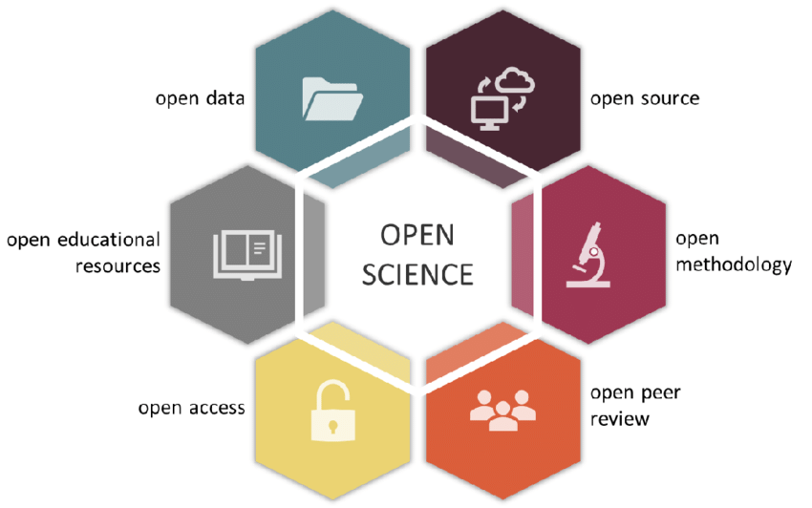

PaNOSC and ExPaNDS and EOSC are contributing to:
Open
Source
Open DATA
Open
Methodology
Open
Education
Open
Science
Open
Access
Open
Peer
Reviews
Notes:
Politique de données FAIR et PGDs
Évaluation FAIR et cadre commun de génération de PIDs
Métadonnées standardisées (Nexus/HDF5, ontologies PaN)
API de recherche fédérée pour les catalogues de données du PaN
Portail Open Data pour la recherche et le téléchargement de données
AAI : UmbrellaId ➔ eduTeams [GEANT service]
notebooks Jupyter et visualisation des fichiers HDF5/NeXus
Plateforme VISA d’analyse à distance + pipelines d'analyse de données
Logiciel pour la simulation de données expérimentales (SIMEX)
Plateforme PaN-training.eu

Slide 9

We had One Common GOAL

Slide 10
We now have one new Common GOAL
Making a PaN Data Commons of FAIR Data from the PaN Community

Slide 11
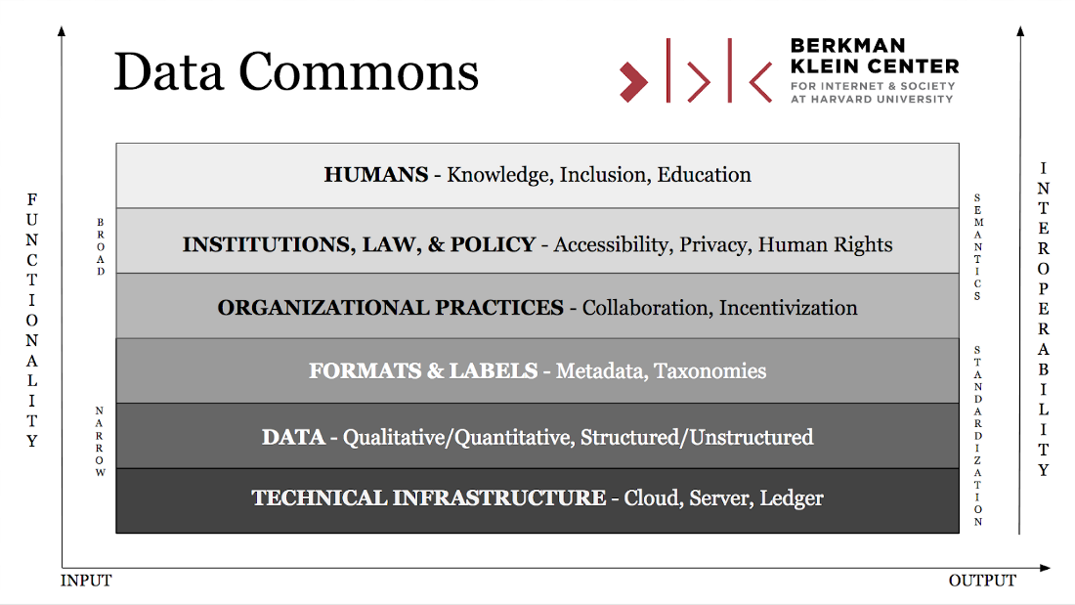
What is a Data Commons

Slide 12
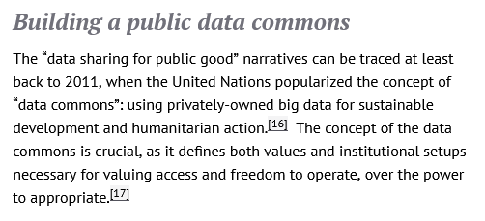
What is a Data Commons?
The overarching goal of the NIH Data Commons was to accelerate new biomedical discoveries by developing and testing a cloud-based platform where investigators could store, share, access, and interact with digital objects (data, software, etc.) generated from biomedical and behavioral research.
https://openfuture.eu/publication/public-data-commons/
https://commonfund.nih.gov/commons
https://datacommons.org/

Slide 13
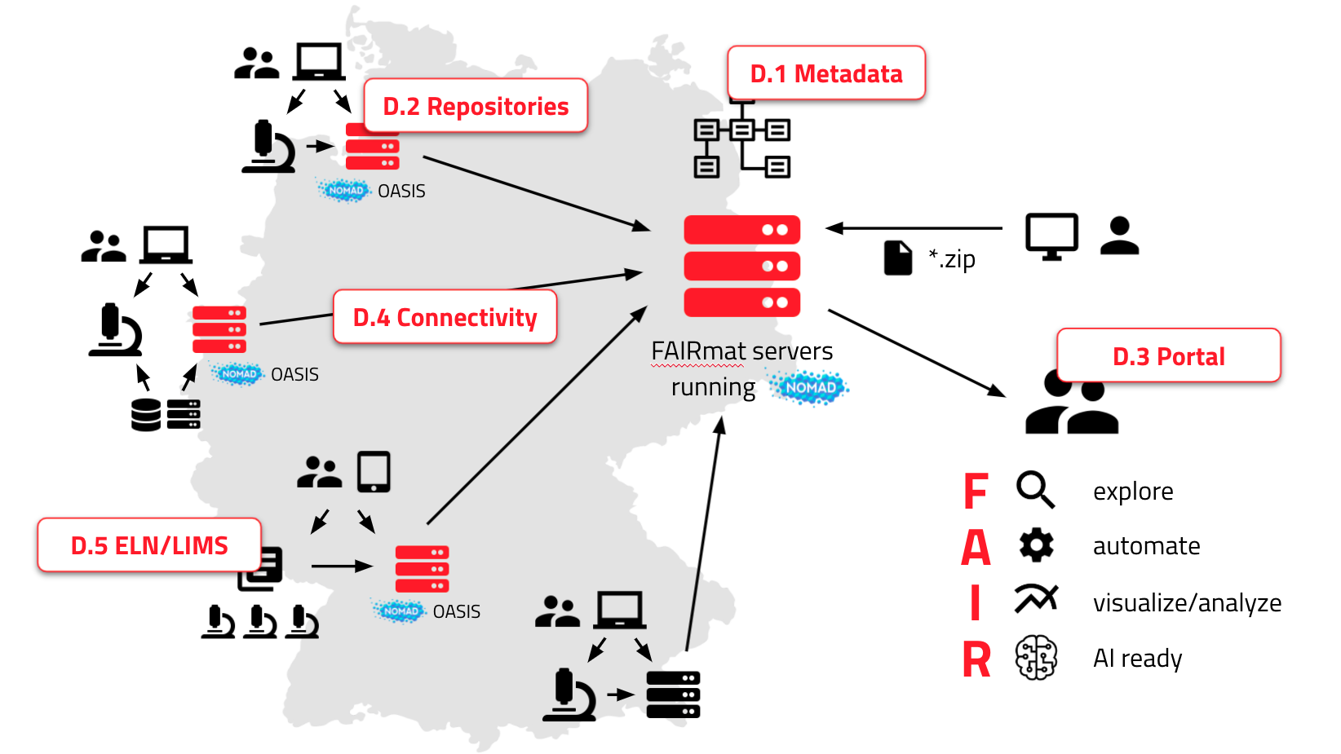
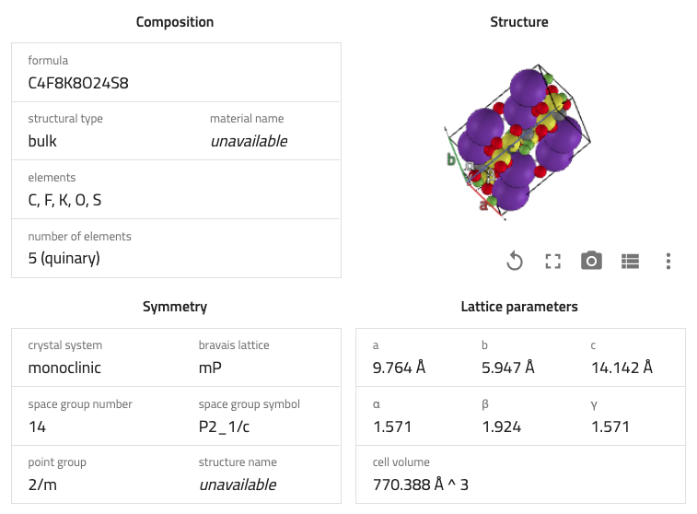
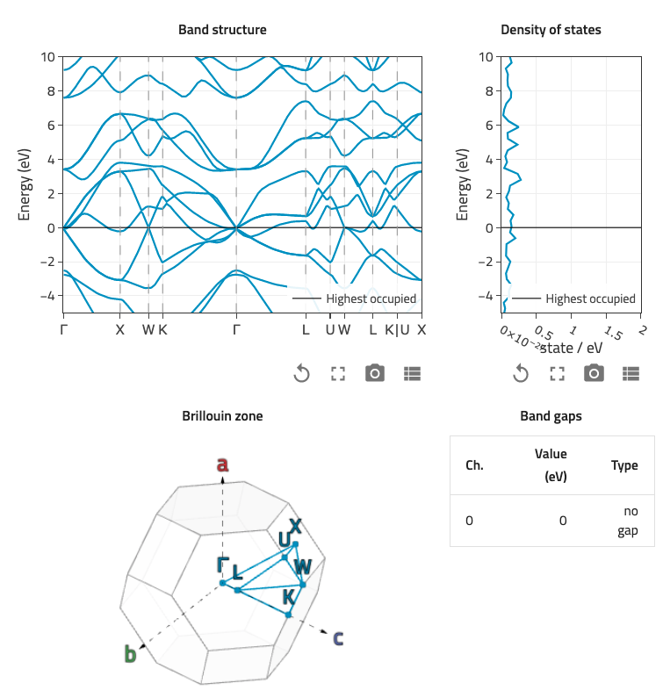
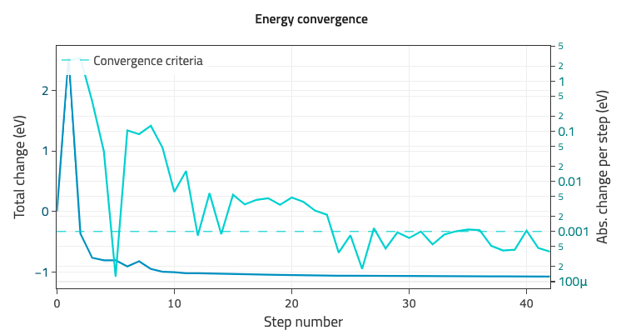
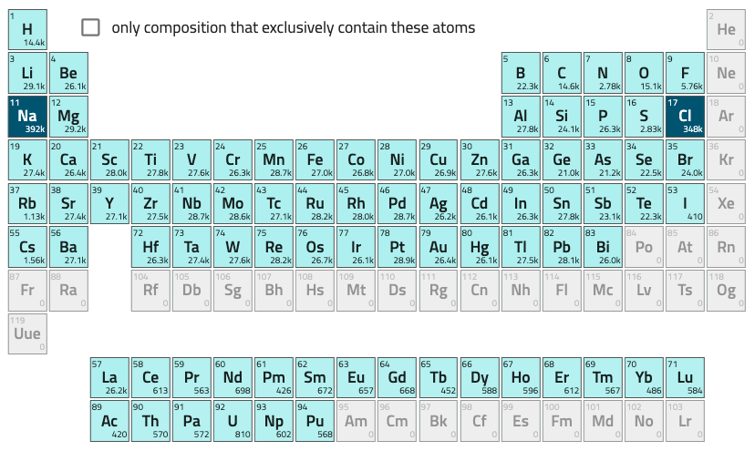
Example of a Data Commons
NOMAD: Publishing research data
More than 12 million of simulations (22 billion quantities) from over 500 authors world-wide
Free publication and sharing data of data
Extracts rich metadata for more than 50 codes
All data in a raw and a common machine readable from
Use integrated tools to explore, visualize, and analyze
Slide courtesy of Markus Scheidgen

Slide 14
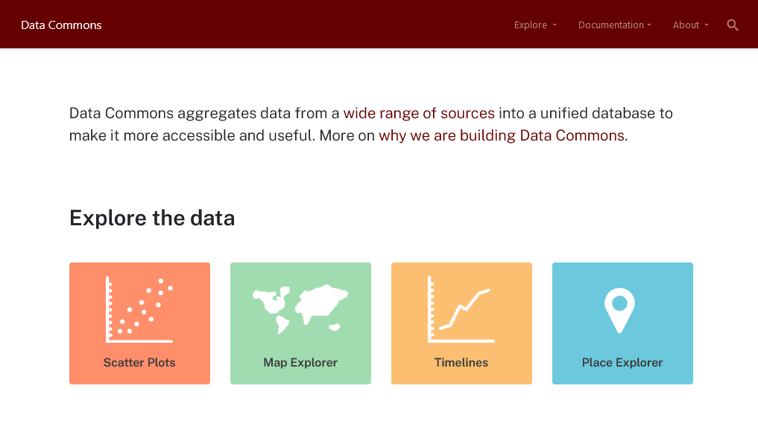
Google Data Commons https://datacommons.org

Slide 15
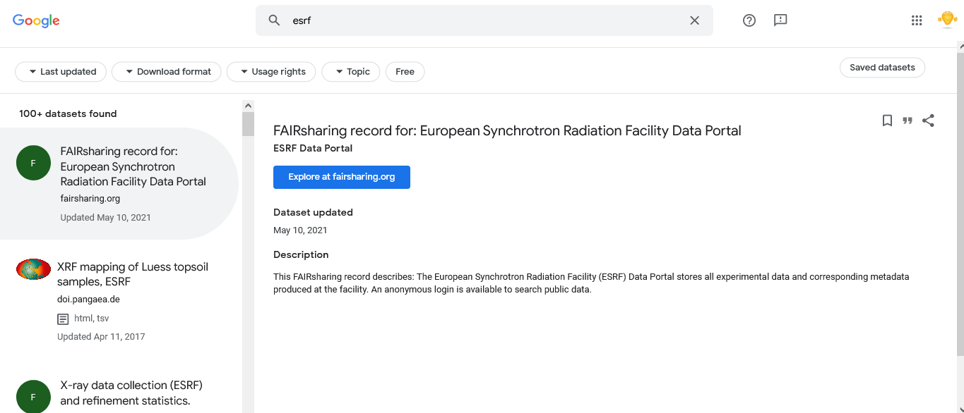
Google Dataset Search:
A poor man’s Data Commons
https://datasetsearch.research.google.com/

Slide 16
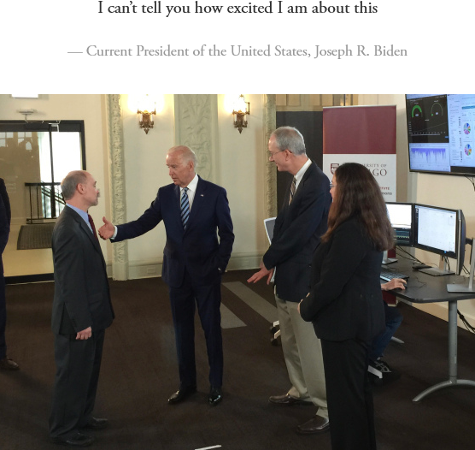
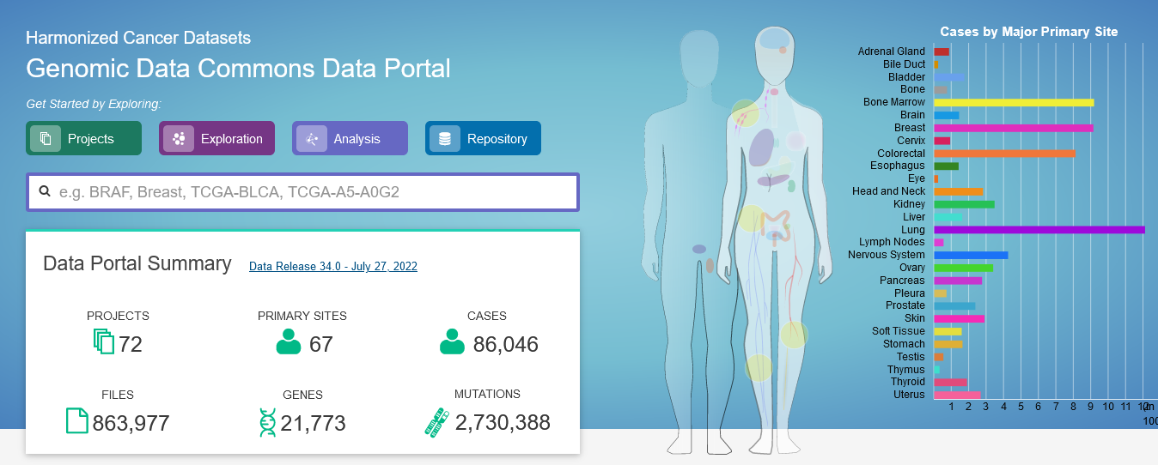
Genomics Data Commons - https://portal.gdc.cancer.gov/

Slide 17
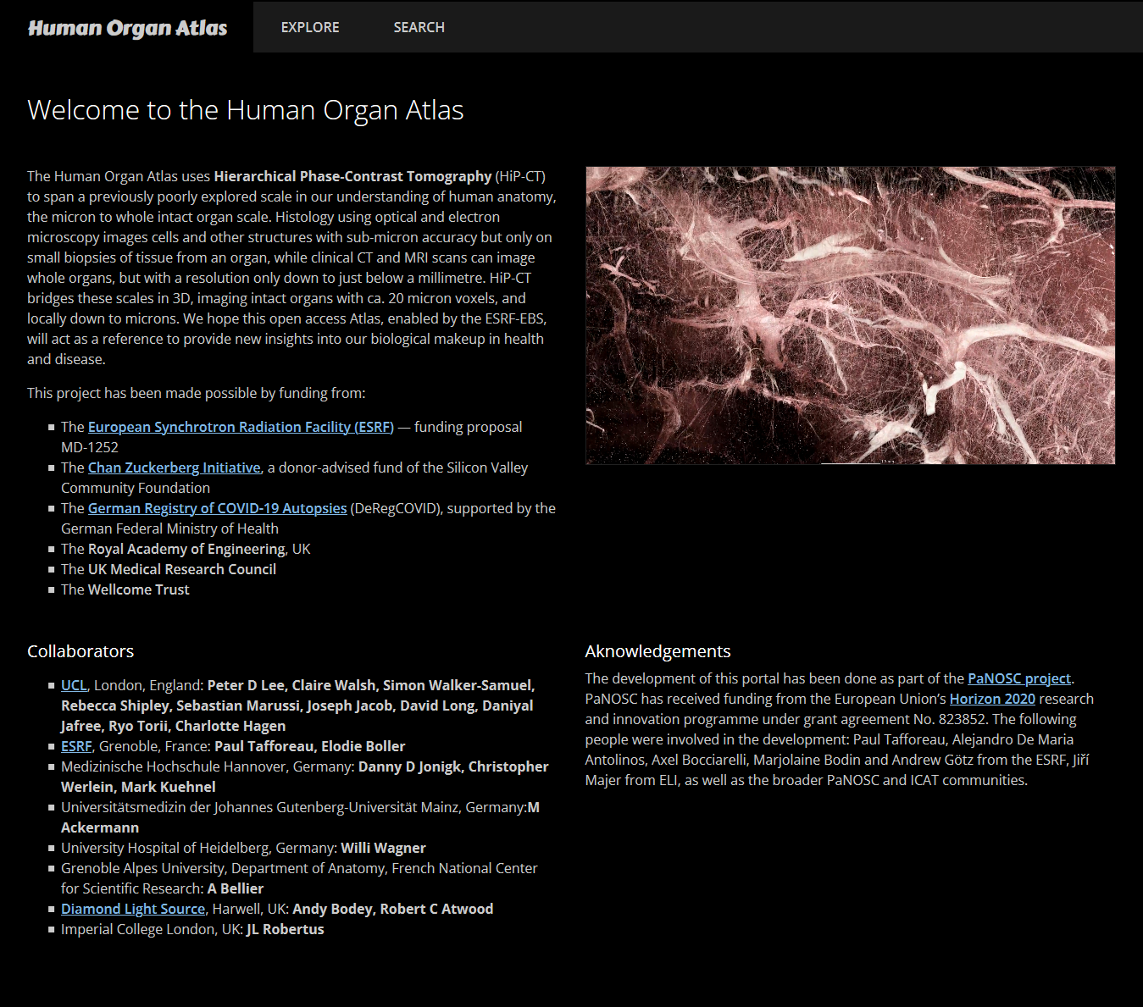
Example of domain specific open data publishing:
Human
Organ
Atlas
*Walsh, C.L., * Tafforeau, P., * Wagner, W.L., Jafree, D.J., Bellier, A., Werlein, C., Kühnel ,M.P., Boller, E., Walker-Samuel, S., Robertus, J-L., Long, D.A., Jacob, J., Marussi, S., Brown, E., Holroyd, N., Jonigk#, D.D., Ackermann#, M., Lee#, P.D. Imaging intact human organs locally resolving cellular structures using hierarchical phase- contrast tomography. Nat Methods (2021) Accepted
https://human-organ-atlas.esrf.eu
refer to PaNOSC Use Case 23 for more info

Slide 18
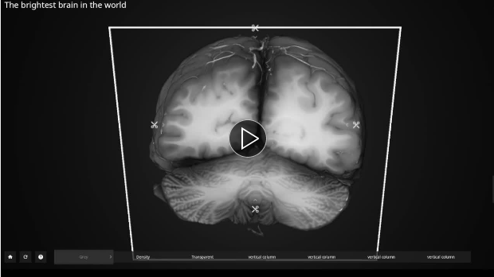


Examples of domain specific open data reuse by commercial companies:
Human Organ Atlas FAIR data reuse
https://www.linkedin.com/posts/isabellewegmannhachette_science-3d-visualisation-activity-6975790784402837504-ym8z
https://human-organ-atlas.esrf.eu

Slide 19
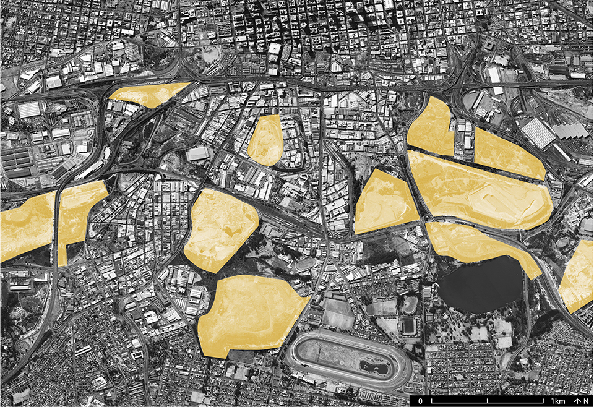
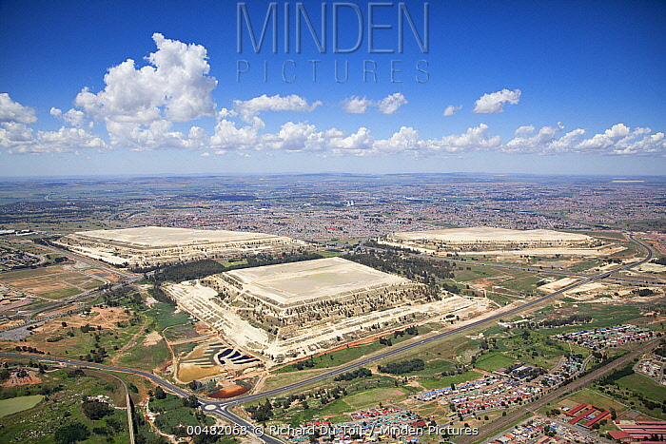
Why make a Data Commons?
Data is sitting around like gold mine dumps …

Slide 20
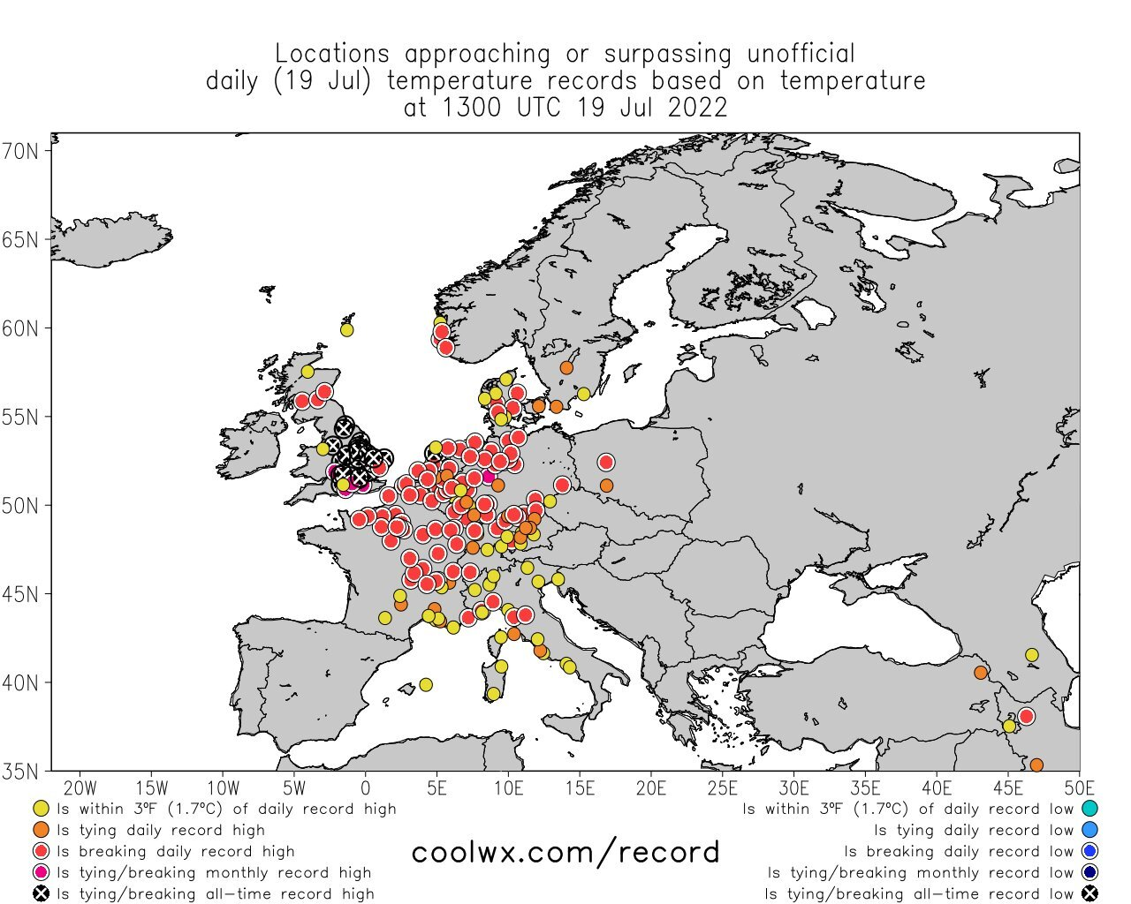
Climate change is more and more visible …

Slide 21
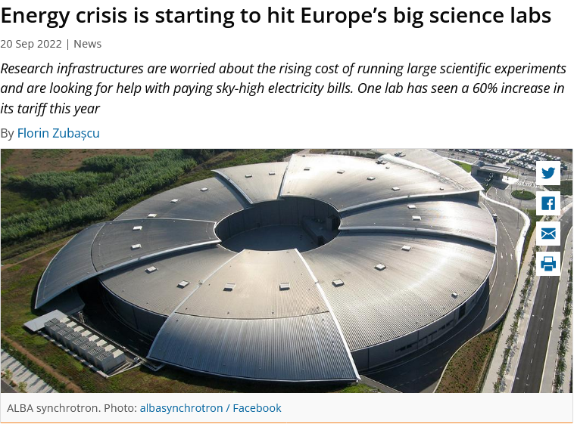

Energy crisis is hitting our labs …
https://sciencebusiness.net/news/energy-crisis-starting-hit-europes-big-science-labs

Slide 22
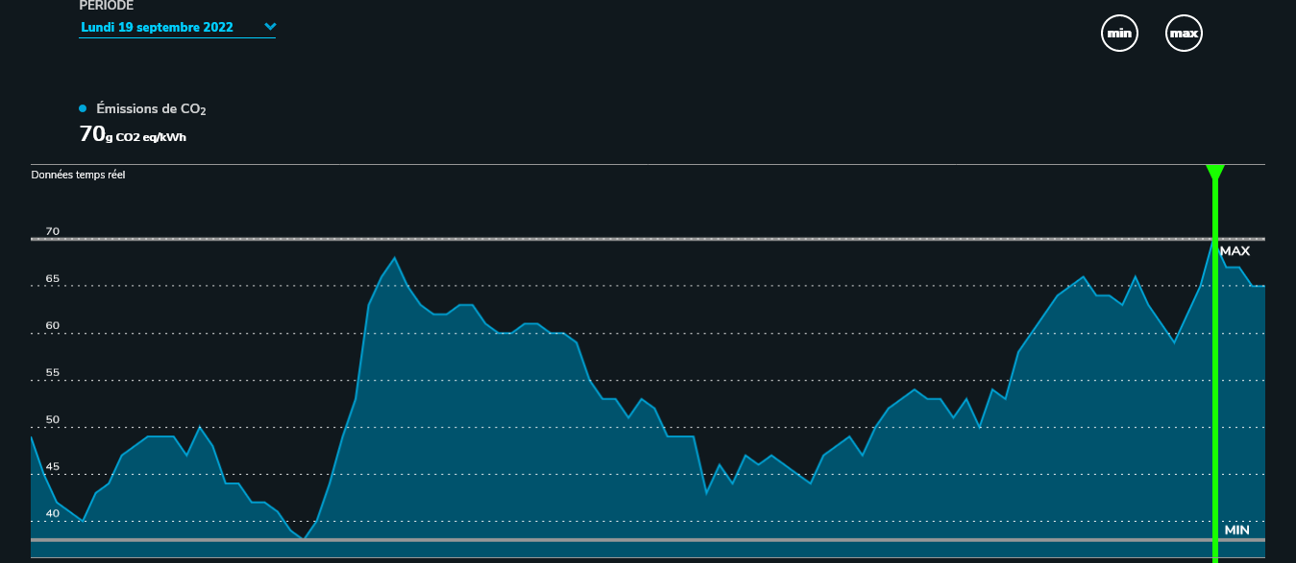
Calculating the carbon footprint of data
User Travel - 3 users fly from Copenhagen to ESRF (380+10 kg CO2e) = 3 x 390 kg
Beamtime energy consumption – 1 week of beamtime (8MW/42) = 190 kWh
Data stored on disk – 100 GB stored on disk (10W x 100 days)
Data processing on site – 1 week of processing on 64 cores (1kW x 1 week)
Data transfer – transfer 100 GB of data back to user (31 kWh)
CO2e per kwH in France (2022) = 75 g/kWh
https://www.rte-france.com/eco2mix/les-emissions-de-co2-par-kwh-produit-en-france#

Slide 23
Estimated carbon footprint of experiment
User Travel = 1170 kg
Beamtime energy consumption = 2056 kg
Data stored on disk = 1.8 kg
Data processing on site = 12.6 kg
Cloud transfer = 2.3 kg
CO2e per kwH in France = 75 g/kWh
TOTAL = 3.253 tons !
Sustainable Goal = 5 tons / human / yr

Slide 24
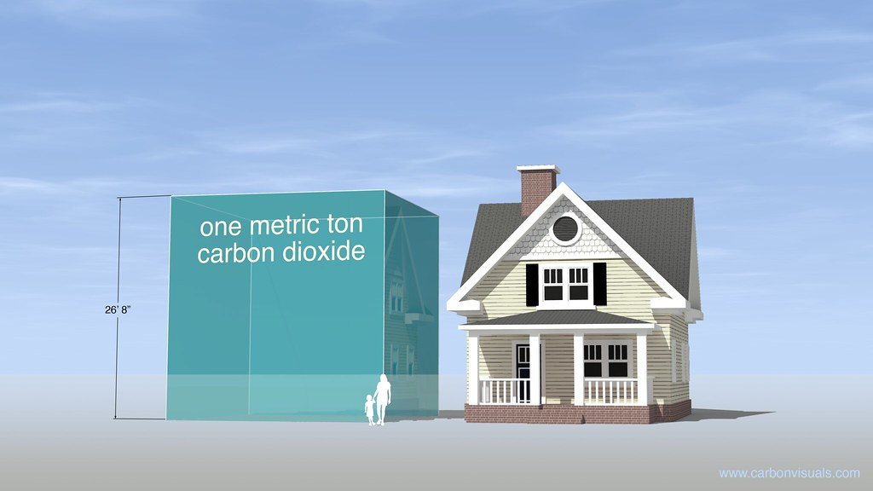
1 week of experiment is equivalent to a cube 30x30x30 metres of CO2

Slide 25

Carbon footprint of archiving data
Data stored on tape for 10 years ~ 200 g * 35 = 7 kg
CO2e per kwH in France = 75 g/kWh
ARCHIVING for 10 years ~ 7 kgs
i.e. 0.2% of the raw data!
7
3253

Slide 26
PaN Data Commons - Concept
Vision – create a common space for PaNOSC and ExPaNDS facilities where petabytes of PaN FAIR data, analysis software, notebooks, workflows, and training material can be Found, Accessed (downloaded and/or executed), Re-Used + Improved i.e. FAIR
Remote access – the PaN commons will be accessible remotely while being executed locally (close to the data) or via the EOSC (data needs to be moved)
Remote users – the PaN commons will enable and encourage remote users and experiments (urgently required in the post-COVID-19 phase and climate change)

Slide 27
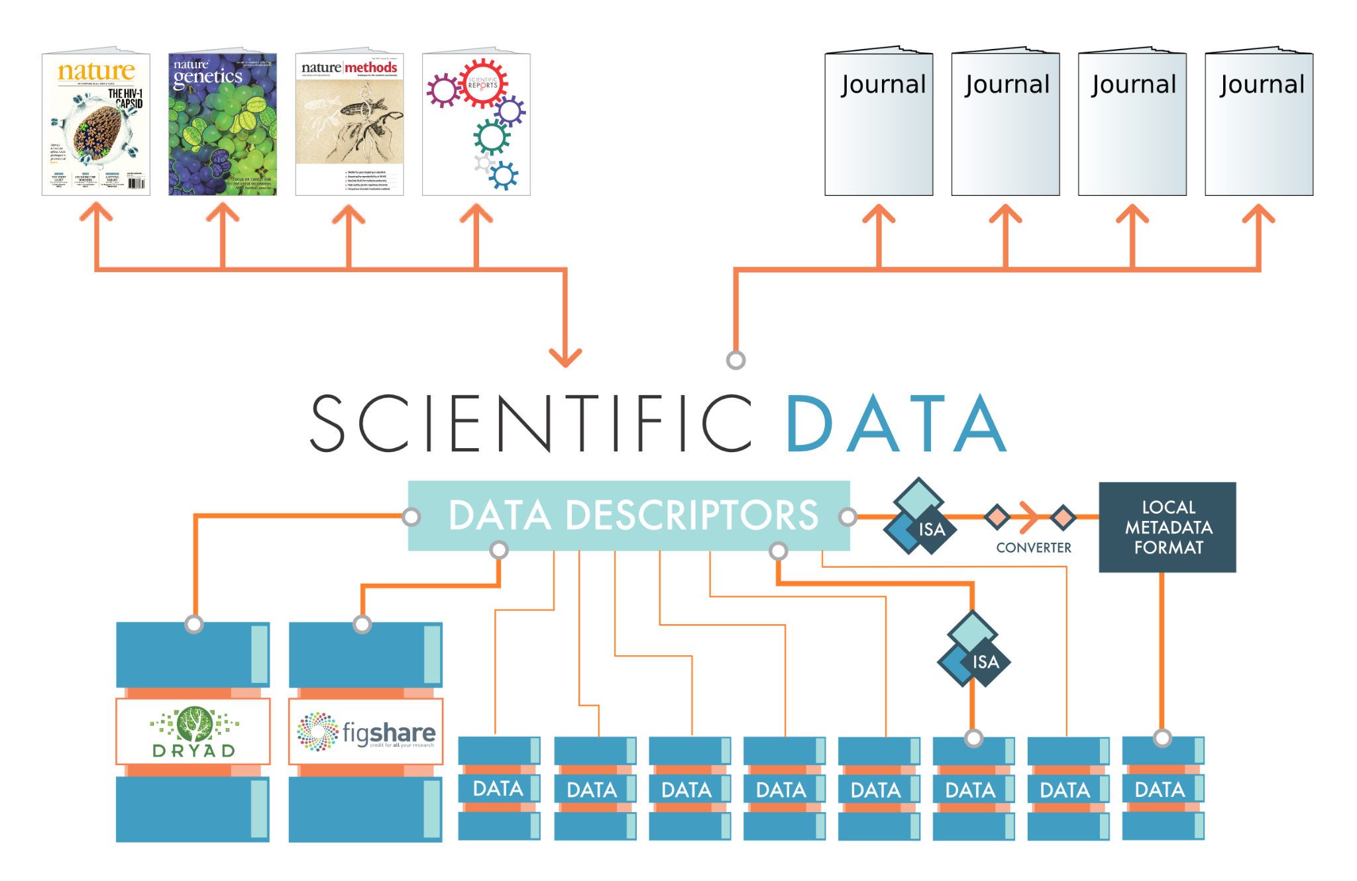












Sustain Published Data Through PaN Repositories
Open Science
Citizen Science
PaN Open Data Repository
Human
Organ
Atlas
PaN Search API
PaN Open Data Portal
Local repositories
image: http://blogs.nature.com/scientificdata/2013/07/23/scientific-data-to-complement-and-promote-public-data-repositories/

Slide 28
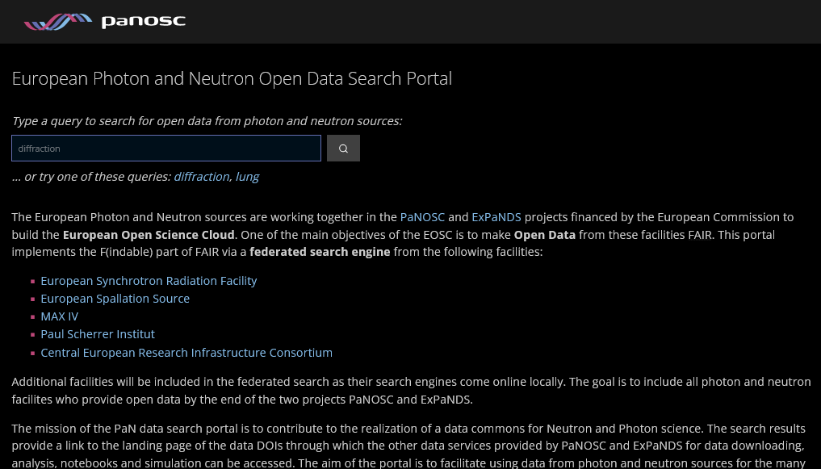
Building the PaN Data Commons on the PaNOSC search portal

Slide 29
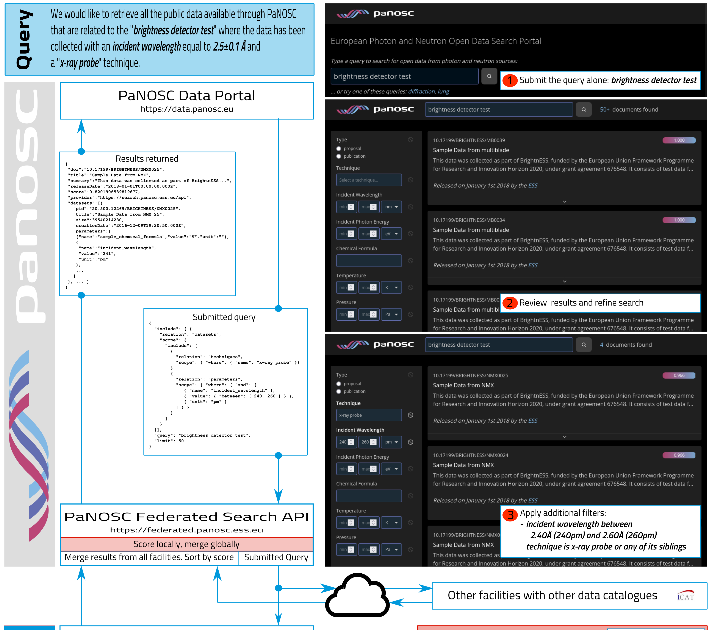
PaNOSC Search API portal @ https://data.panosc.eu DEMO!
Source: “SciCat implementation of the PaNOSC Search” by Max Novelli (ESS) et al, https://indico.psi.ch/event/12738/contributions/38937/

Slide 30
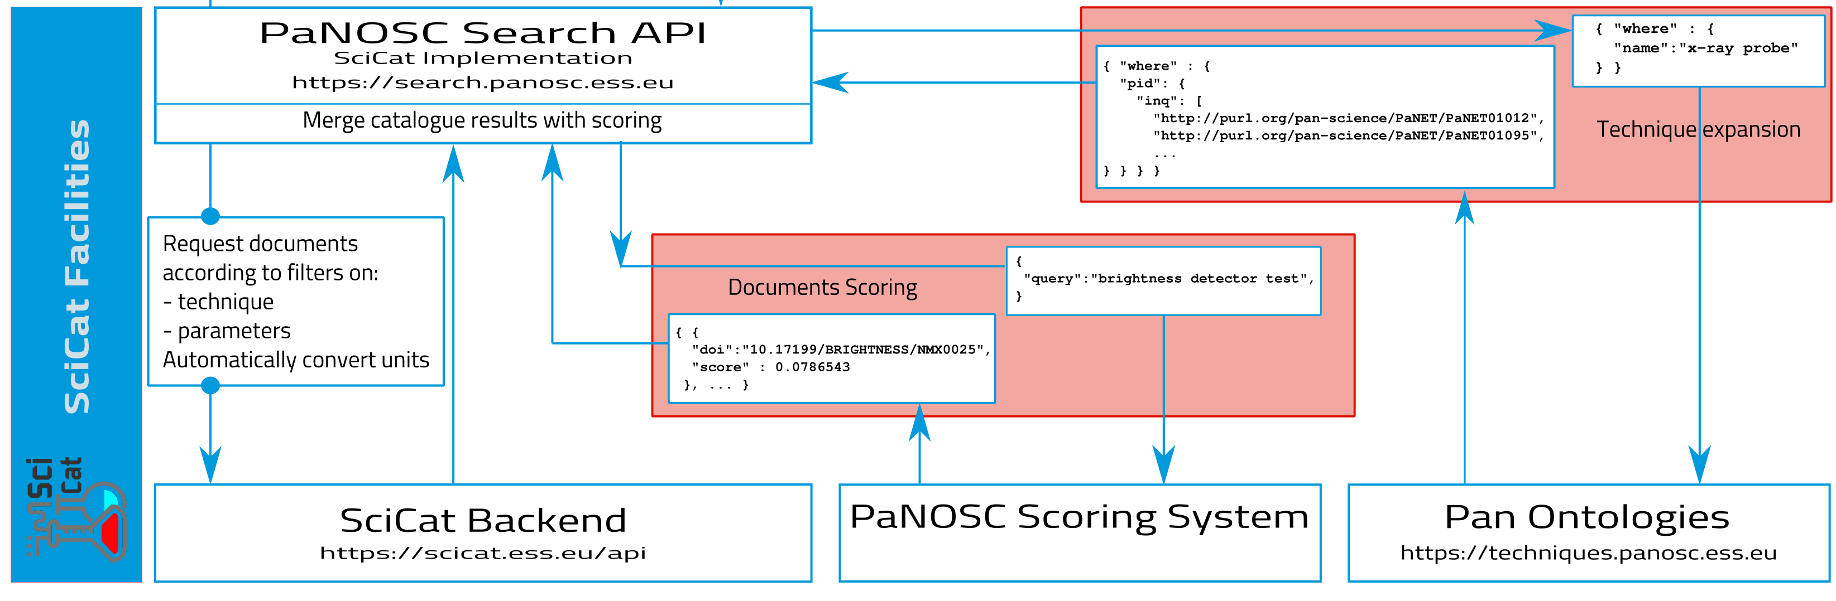
PaNOSC Search API – implemented on top of SciCat
Source: “SciCat implementation of the PaNOSC Search” by Max Novelli (ESS) et al, https://indico.psi.ch/event/12738/contributions/38937/

Slide 31

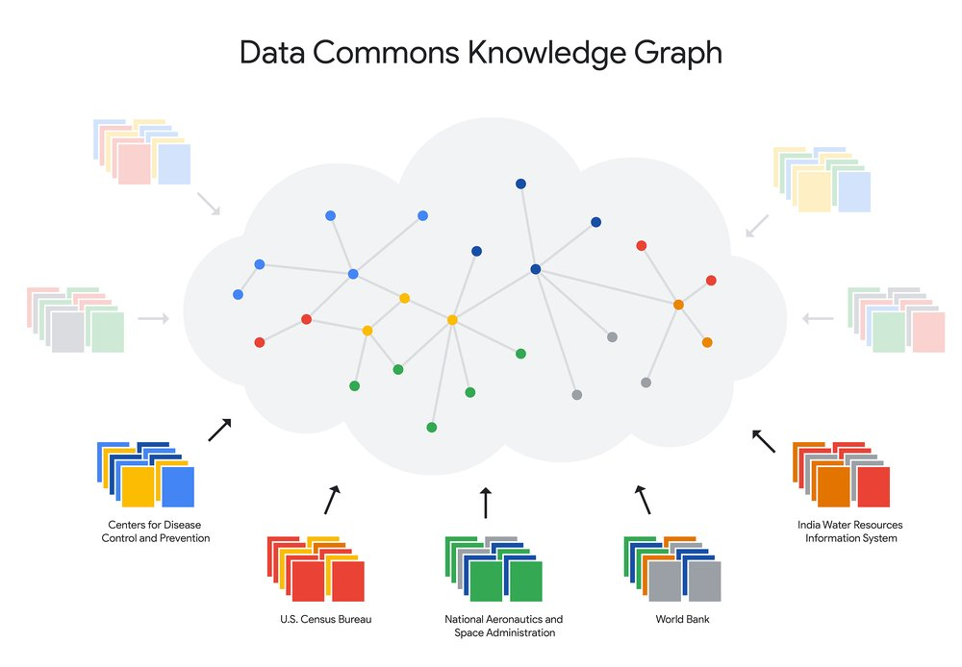
What we need from YOU:
Implement a open data repository
Deploy the PaNOSC Search API + scoring
Connect your search endpoint to the PaN Search Portal
Data stewards to curate metadata
Train your scientists in FAIR data
Help build a knowledge graph

Slide 32

Conclusion
ExPaNDS and PaNOSC have laid the foundations for a PaN Data Commons
The outcomes of the two projects will enable a PaN Data Commons of FAIR data
A PaN Data Commons will preserve and increase data reuse
Finance to sustain a Data Commons will come from facilities + EOSC
The PaN community is on the road to becoming part of the FAIR data landscape
Saving our data helps fight climate change and supports open science

Slide 33
Useful links
ExPaNDS - https://expands.eu/
PaNOSC - https://www.panosc.eu/
EOSC Association - https://eosc.eu/
PaNOSC data portal – https://data.panosc.eu

Slide 34
Sources used for carbon footprint estimates
User Travel - https://calculator.carbonfootprint.com/calculator.aspx?tab=3
Beamtime energy consumption – ESRF electrical monitor + control system
Data stored on disk – https://www.buildcomputers.net/power-consumption-of-pc-components.html
Data processing on site – https://www.buildcomputers.net/power-consumption-of-pc-components.html
Data transfer+storage in cloud – https://medium.com/stanford-magazine/carbon-and-the-cloud-d6f481b79dfe
Tape storage - https://datastorage-na.fujifilm.com/reducing-carbon-emissions-through-the-data-tape-ecosystem/
CO2 by kWh in France - https://www.rte-france.com/eco2mix/les-emissions-de-co2-par-kwh-produit-en-france#
https://sciencebusiness.net/news/energy-crisis-starting-hit-europes-big-science-labs

